Slide 1
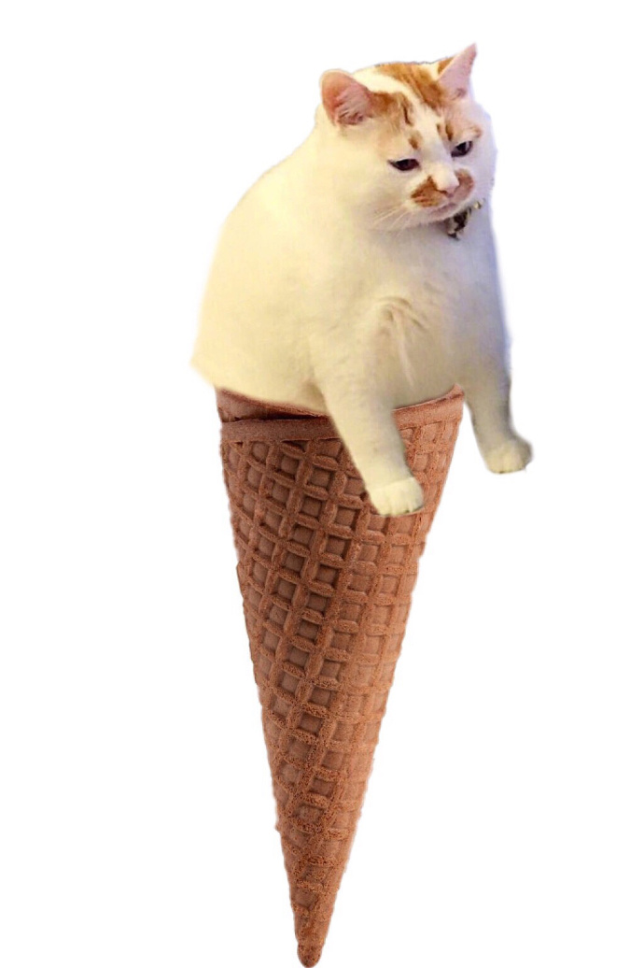
“Keeping cats” on the Internet:
Cat celebrities on Weibo

Slide 2
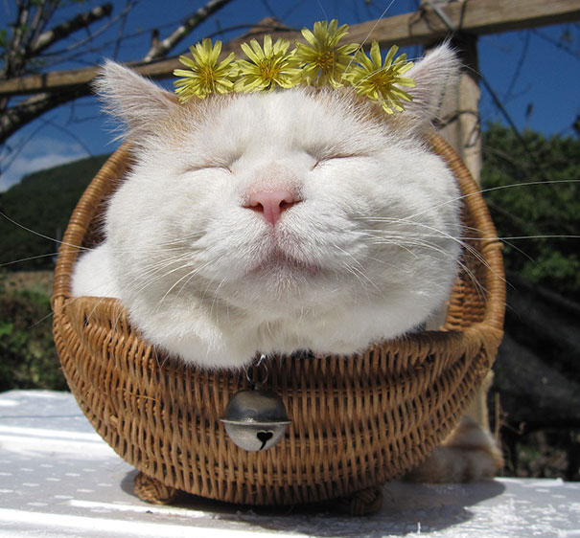
Introduction: Cats and the Internet
Images and videos of domestic cats
Cat online celebrity: Eg. Grumpy Cat, Lil Bub, Shironeko
CNN: 6.5 billion cat pictures on the internet (2015)
Notes:
Getting more popular on the internet
Playing an important rule on our virtual world
CNN estimated that in 2015 there could be around 6.5 billion cat pictures on the internet

Slide 3
“Keeping cats” on the Internet “雲養貓”
People who want to keep a cat
Fulfill their desire by watching the online pictures and videos of the virtual “cat”
Feature of pictures:
Mimic the experience of keeping domestic cats
Convey the viewer that you are related to the cats
Vocab: cat petting 擼貓
Notes:
Medium weibo in mainland
Possible reason

Slide 4
The Production of Pet Celebrities:
China's network and Weibo platform
There are platform restrictions in mainland China, where only state-run social media are allowed. (eg. Sina Weibo and QQ)
These companies can hold a huge number of users.
They monopolize the mainland's network and suppress the influence from foreign Internet platforms
New hot topic which takes place can widespread quickly
Notes:
People only have few choices
Hot topic can spread through this “closed” system really quick
Rap in china, some sentences said by the producer, this programe easily gained attention so much on weibo

Slide 5
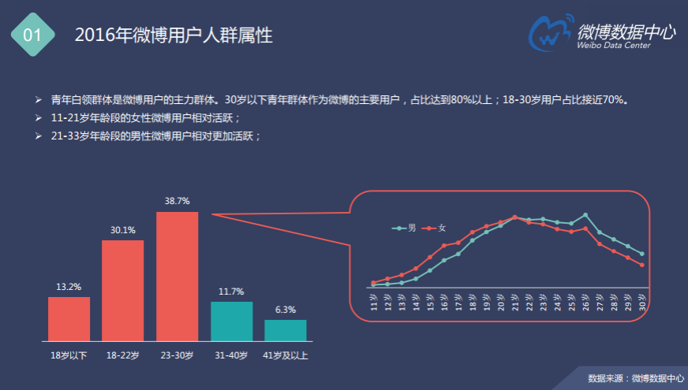
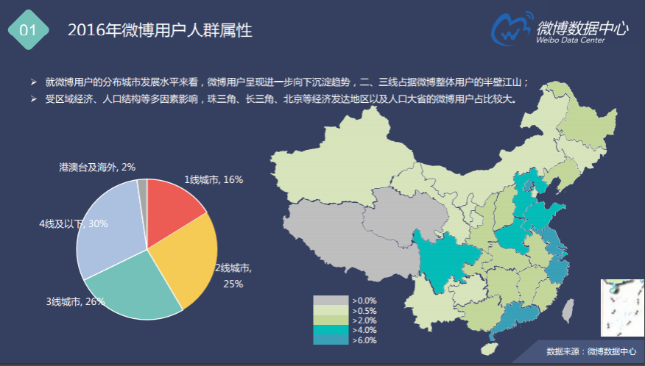
The Production of Pet Celebrities:
"cuteness" of pets satisfy the spiritual needs of the "Empty-nest youth"
(Weibo’s 2016 report showing the age and region distribution of the active users)
Notes:
As we can see the main user of weibo is people who are under 30. it takes up 70% of the active users in 2016. and most of them are form the more developed cities such as Shanghai and Beijing

Slide 6
The Production of Pet Celebrities:
"cuteness" of pets satisfy the spiritual needs of the "Empty-nest youth"
"empty nest youth" in China.
"Empty nest youth" 空巢青年 : → Living away from their hometowns because of study or work → Facing poor economic and emotional conditions
Notes:
they actually share some common characteristics with the so-called "empty nest youth" in China.
who are away from their hometowns to some more developed cities.
They are facing multiple problem : facing poor economic conditions as well as the lack of emotional sustenance.
Social reason underlying this phenomenon

Slide 7
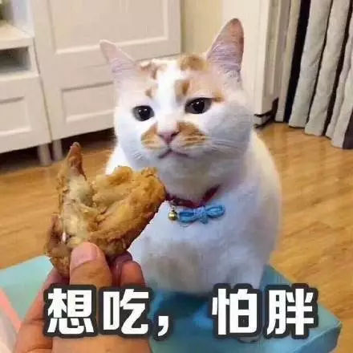
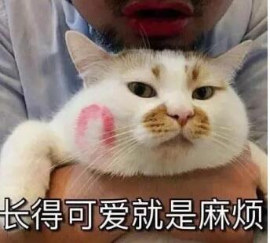
The Production of Pet Celebrities:
The Weibo meme culture
表情包 culture: creative language with interesting image
Caption are added to pets' Photo by their fans
People use it as emoji in QQ or Wechat
“Want to eat. Afraid to be fat.” “Being cute is so annoying”
Notes:
The rise of this phenomenon is closely related to the weibo meme culture
creative language, interesting images
Many people who don’t know about the cat before can get attached to them,
It help the cat celebrity to reach a huge amount of audience.

Slide 8
The Production of Pet Celebrities:
Example: Loulou (樓樓) ➤ Weibo Fans: 686,465 ➤ A Fat Tomcat ➤ Famous for its hilarious memes ➤ Died in 2017/10/14
Notes:
This fat tomcat is famous personally but only for his hilarious memes made by his fans

Slide 9
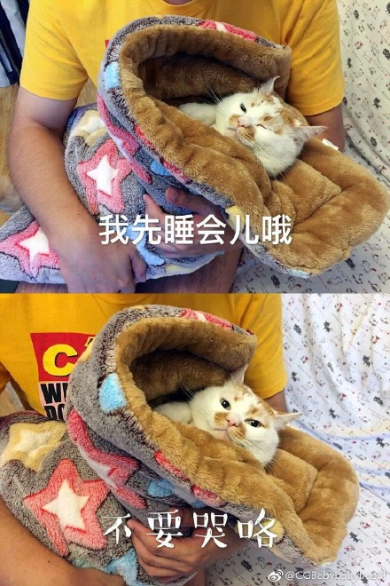
The Production of Pet Celebrities:
People spontaneously created new memes to commemorate him
The celebrity image of cats are created and maintained by the receptors instead of the marketers
“Here I go. Don’t be sad. I will turn into another cat to be with you.”
“Just a nap.”
“Don’t cry”
Notes:
After his death,
the celebrity image of cats are recreated and maintained not only by the marketers,
but also by their fans who are assumed to be the receptor originally
Really unique feature we can find on this online cat raising phenomenon

Slide 10
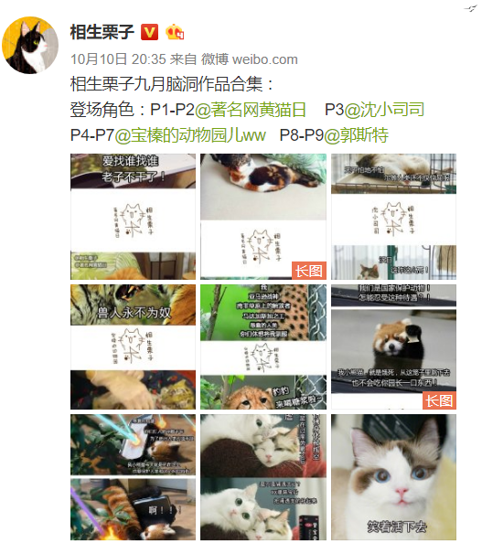
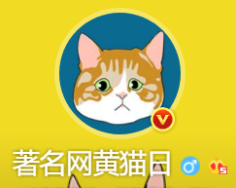
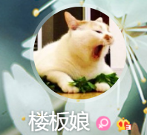
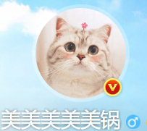
A Specific And Complete Industry
Pet celebrities on Weibo are never alone
They form a group commercially or privately.
Through forwarding or refering
Notes:
Only Created and served the need and welfare of the net citizens in mainland china ?
commercialism to further explain this.
There are so many ways to get profit by cat on Weibo platform.
to attract more followers and make their advertisement to reach more people.

Slide 11
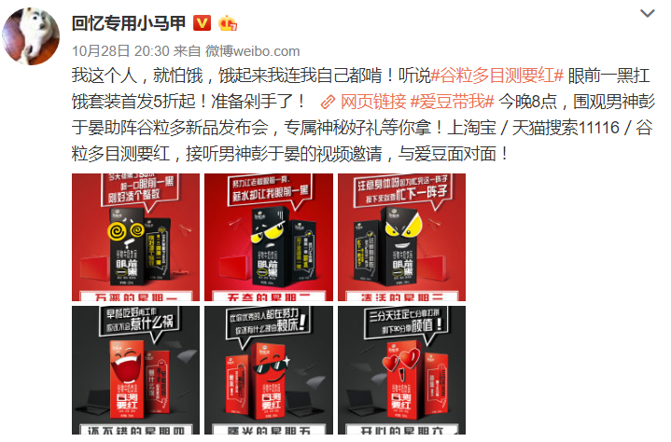
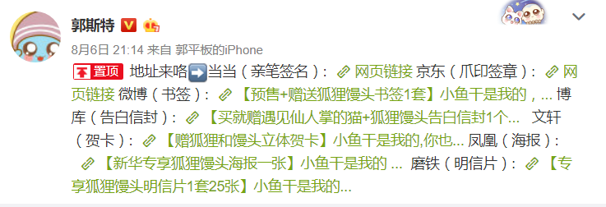
A Specific And Complete Industry
just a food product
Create Related products
Simply post some advertisments
（may not be relevant to pets）
（book,poster,postcard,bookmark,envelope）

Slide 12
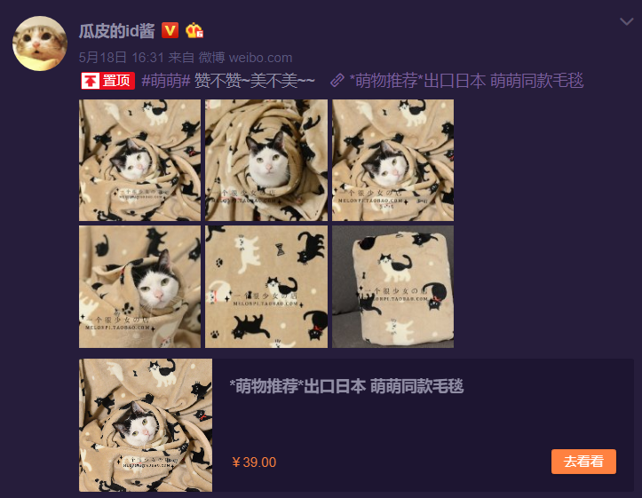
A Specific And Complete Industry
Cooperate with online merchants
Sell blanket that just has cat images on it
(this advertisement is on the top position of this pet celebrity)
A function on Weibo
To show some basic information about the product refered by user
（Name, picture, price, a button“to have a look!”）

Slide 13
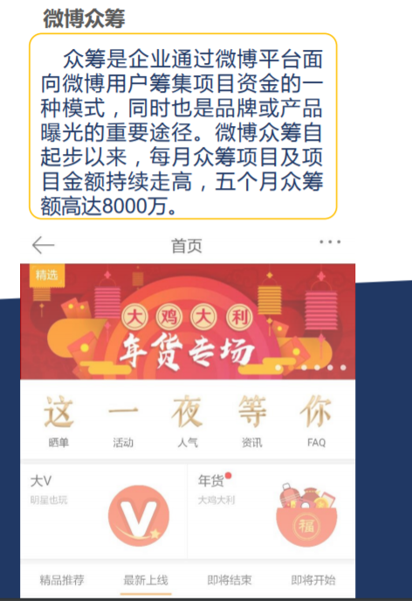
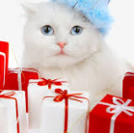
A Specific And Complete Industry
Crowdfunding on Weibo
Gifts, food or money sent from followers to owners
The commercial atmosphere is encouraged by Weibo and well-known to both the pet celebrity and their followers.It is never a secret and accepted by the followers as long as those pet celebrities keep the cat well.
Money is one of the ways to show followers’ love.
Notes:
The commercial atmosphere on Weibo and the whole structure of industry can be an important influence factor.

Slide 14
The affect caused by this phenomenon
1.) Raised people’s concerns on cats
-more people want to keep a cat
-Adoption rather than buying new pet
-Criticize of abandoning pets

Slide 15
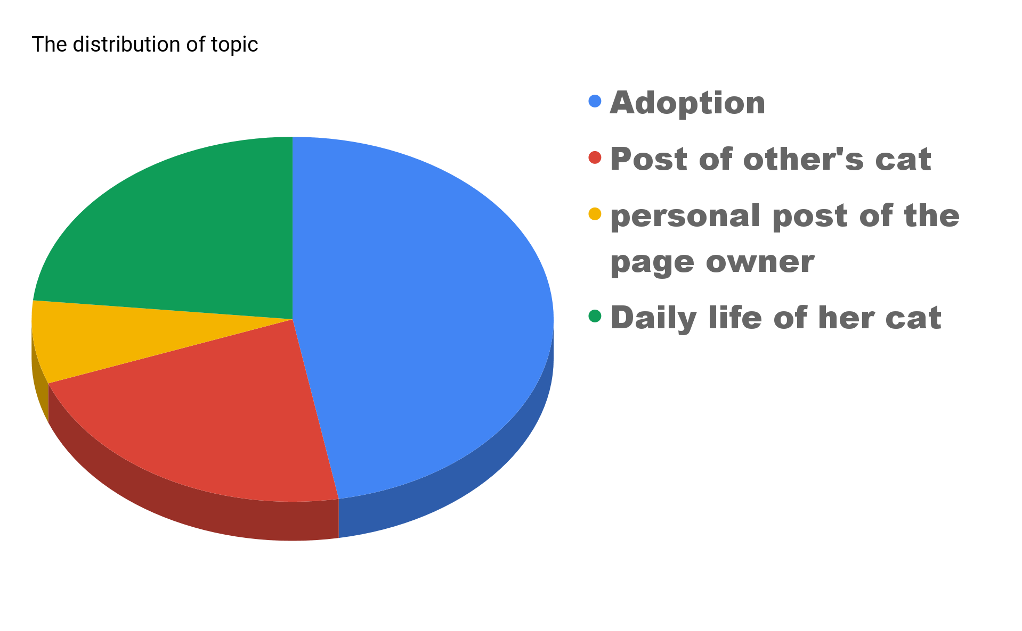
Notes:
Using the acount of “瓜皮的id酱” as an example, when we going through all of her posts in octobor, we have discovered that about half of her posts are the sharing of adoption news. The proportion of adoption news is even larger than the daily life of the page owner’s cat.

Slide 16
Post that about finding new famiy for cat
Notes:
Here are some example of the sharing post about adoption.

Slide 17
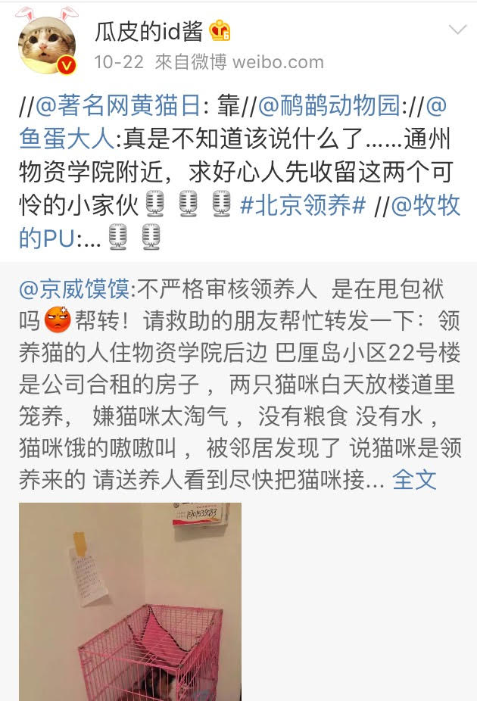
Post about criticizing people that abandoned the cats after adopting them.
Fans’comment of critizing people are not responsible to life

Slide 18
Comment about removing the dog tag can indeed help it when it get lost
Comment about the discussion of sterilization
Comment about how to ensure whether people are suitable for adoption or not
Notes:
Through all those example we can see that the sharing by the page owner can help to raise the concerns on the animal welfare. Meanwhile, it triggers the discussion about cats like sterilization OR the requirement for adoptio. People can gain knowledge about cats issue from them

Slide 19
The affect caused by the phenomenon
2.) From spiritual culture to business culture
-Before: Sharing/gaining contentment of mind
-Now: becoming a new type of business
eg. The product of the cats (book, photo, cusion)
Advertisement
The support from the fans
(buy clothes/food for the cats)
Notes:
Raising a cat from a private experience(spiritual fulfillment of oneself)
Into a commercialized online culture

Slide 20
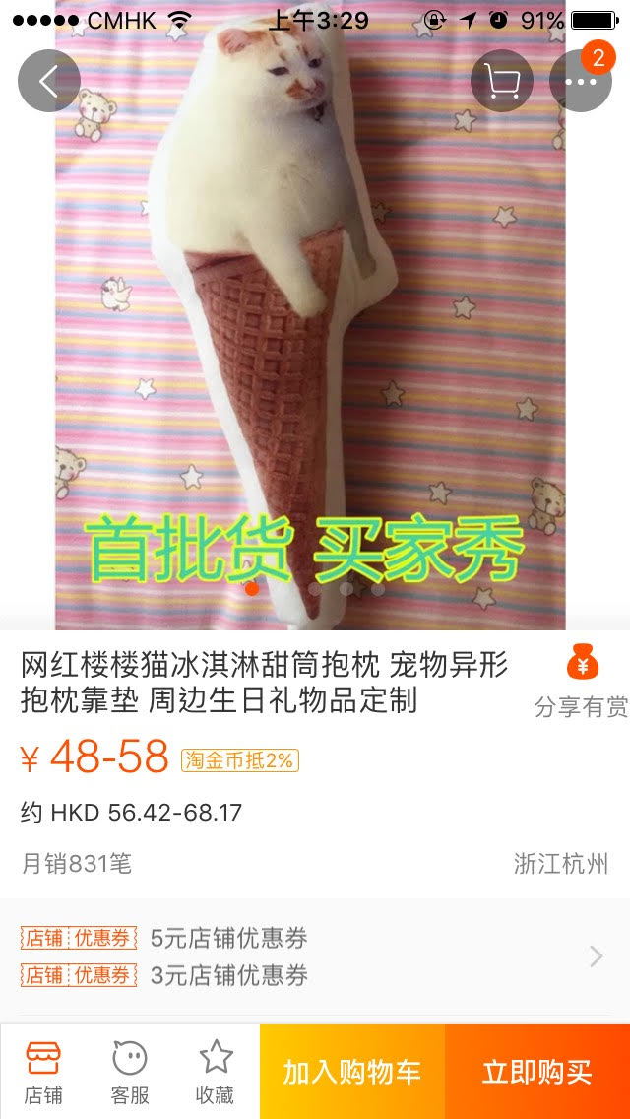
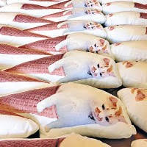
Notes:
It’s the cusion of the famous cat ‘Loulou”. Not only the page owner will made it, but also other shop may do so.

Slide 21
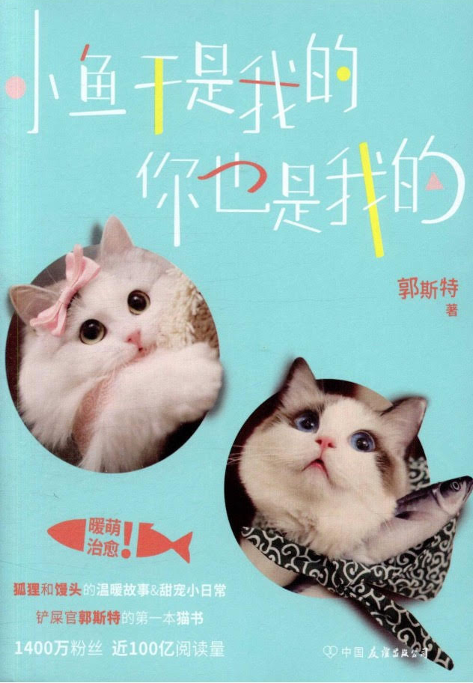
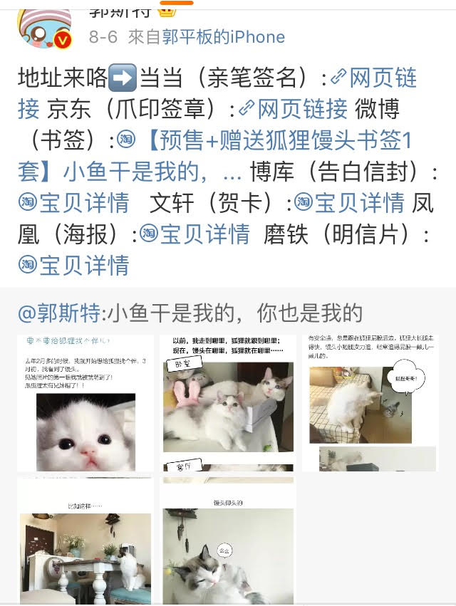

Slide 22
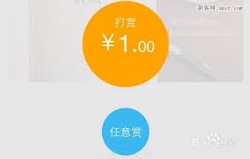
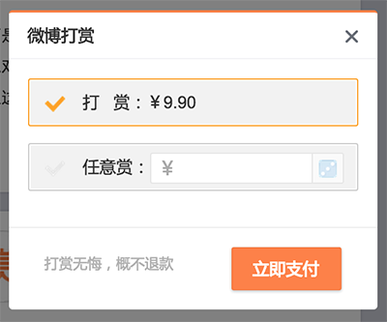
Notes:
The fans can give money to the page owner in order to support the cat/exthough the tips function of Weibo

Slide 23
The affect caused by the phenomenon
3.) Shaping the image of cats and turn cat raising into a refined manner
- Cats are meticulously dressed up by their owner
- Setting up a high standard of cat raising
Notes:
Well treated by their owner online
Set up a real modal for people to follow
If you can not meet up with the high standard, you will be blameed by all the cat lover on the internet
Achievable for most people?
Just part of them who have are rich enough and can afford all these spending on cat?

Slide 24
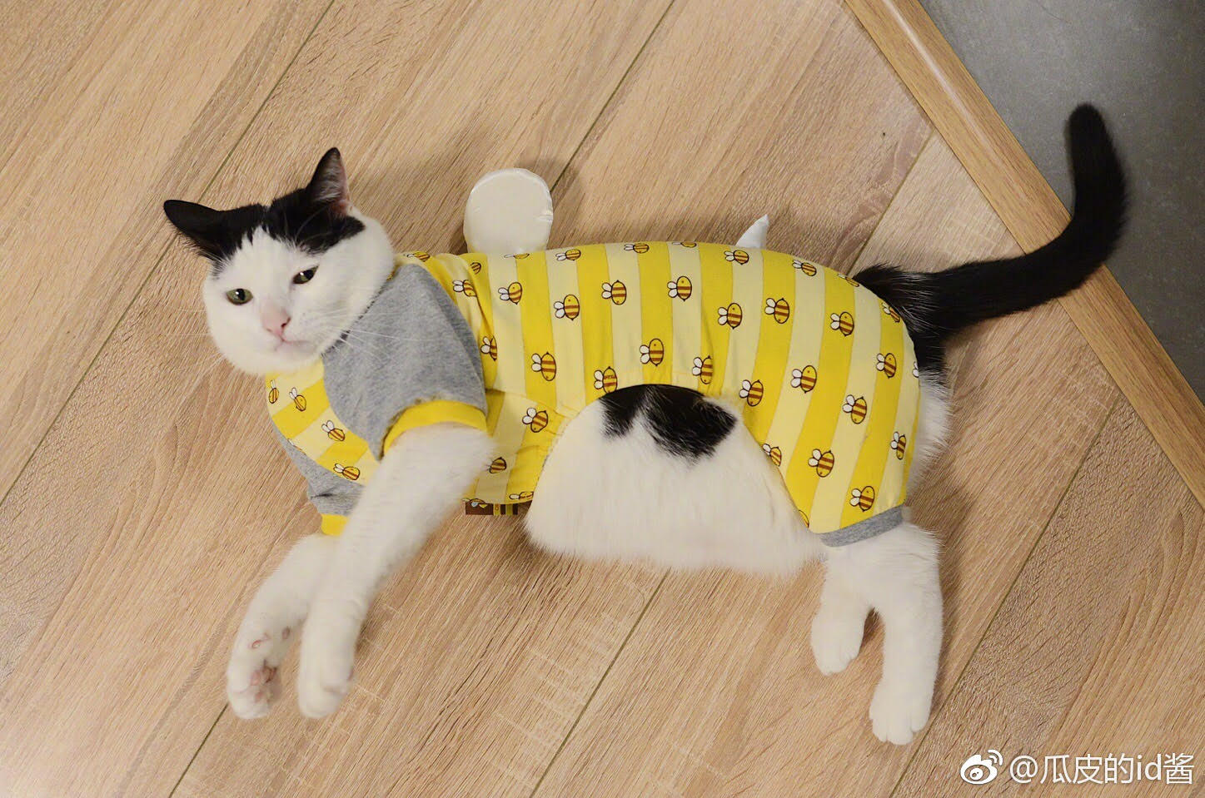
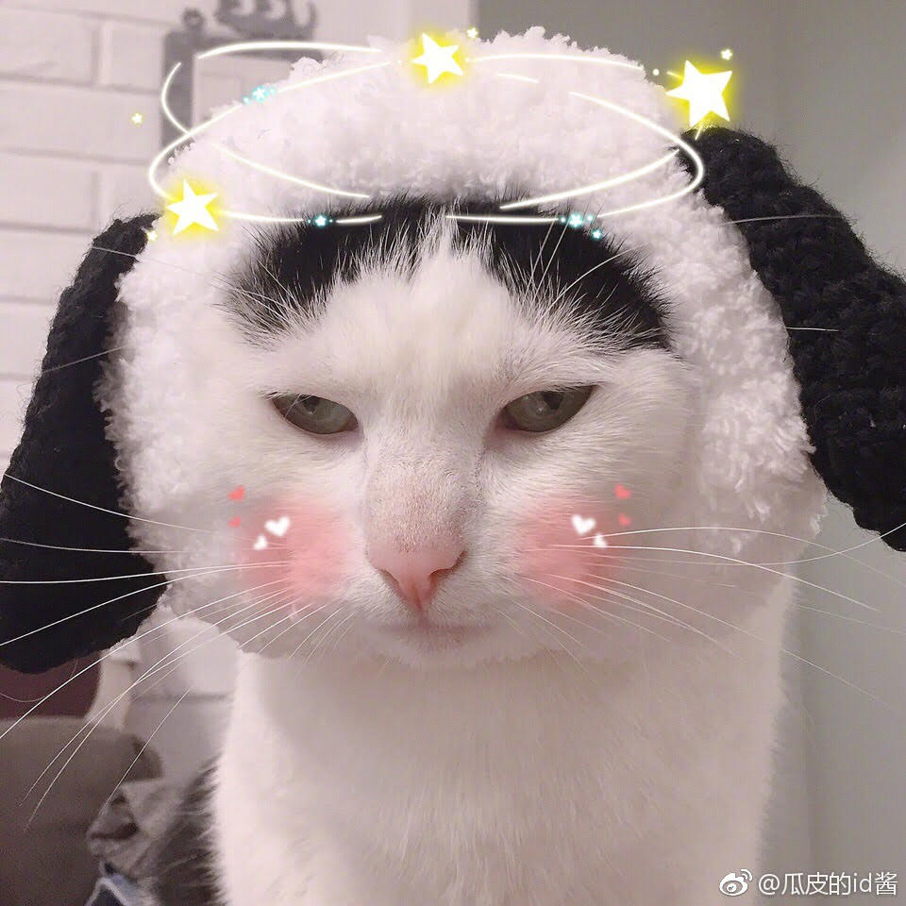
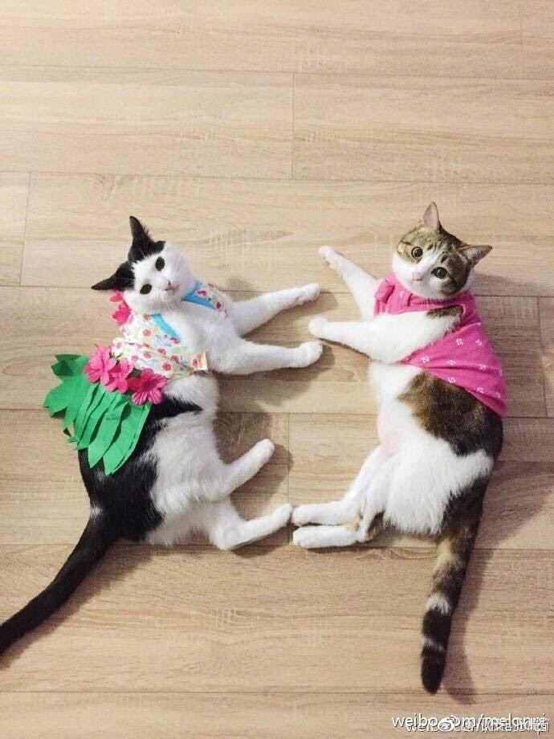
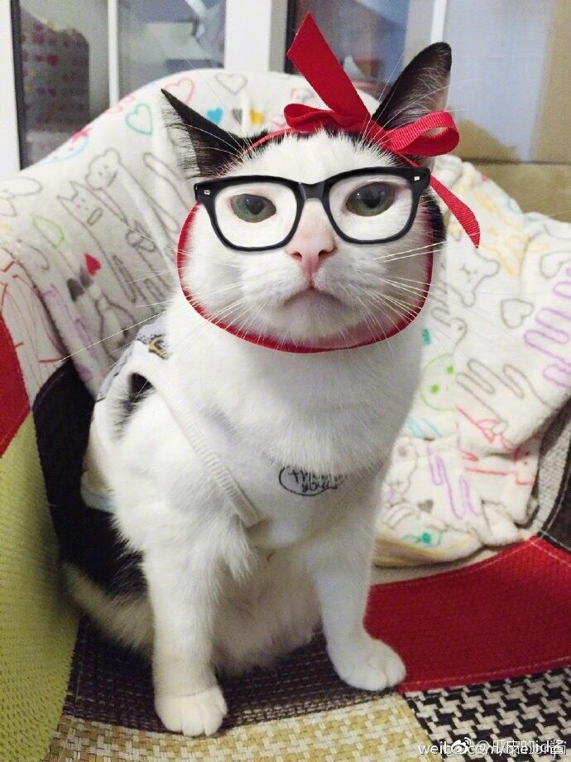
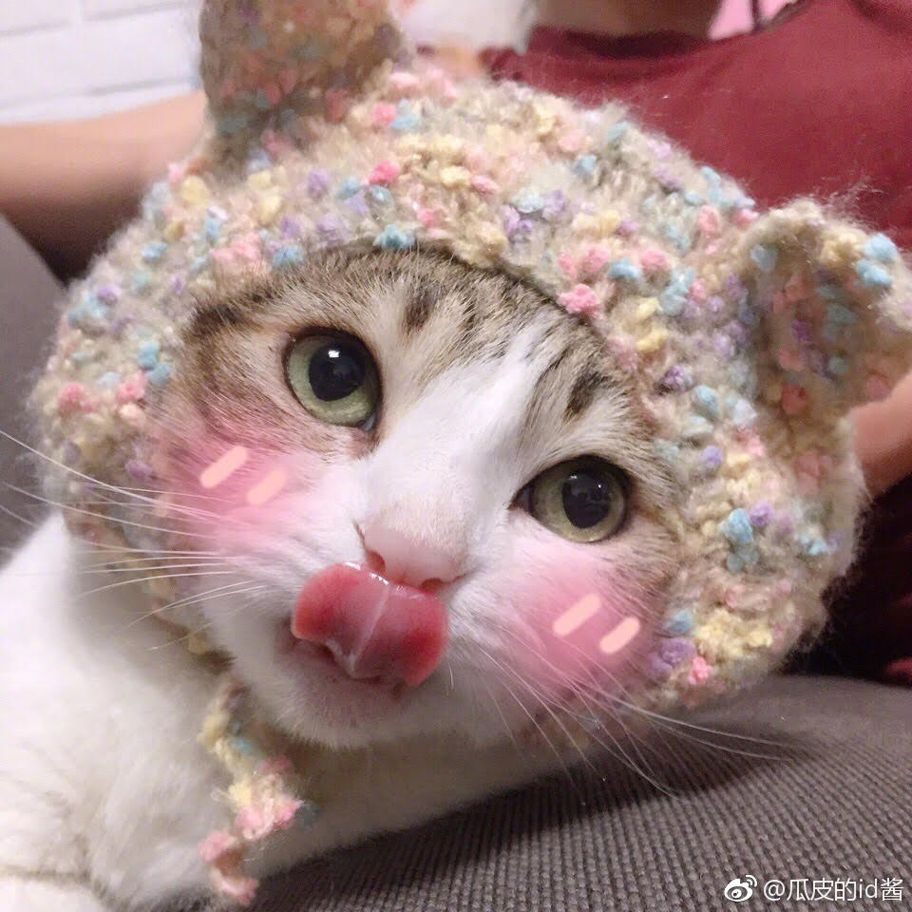

Slide 25
Question
Malcolm Gladwell has described the online relation and the real life relationship as “weak connection” and “strong connection” in his article “why the revolution will not be tweeted” .
How would you descripted this virtual cat raising phenomenon by using Gladwell’s idea?
Which kind of relationship do you prefer when you are raising cats?

Slide 26
Reference
¹ Manya Koetse. The Power of China’s Internet Memes. WEIBO: Reporting Social Trends in China. 8/11/2015
https://www.weibo.com/2049389352/Fqjogx7T4?refer_flag=1001030106_&type=comment#_rnd1509290452614
http://data.weibo.com/report/reportDetail?id=346

